Slide 1
Under Persian Rule
Agriculture was the main way of life
Levied taxes on manufacturing mines and trade
Coined money replaced trade and barter
Government regulated wages and maintained a standing army
Constructed canals for irrigation systems

Slide 2
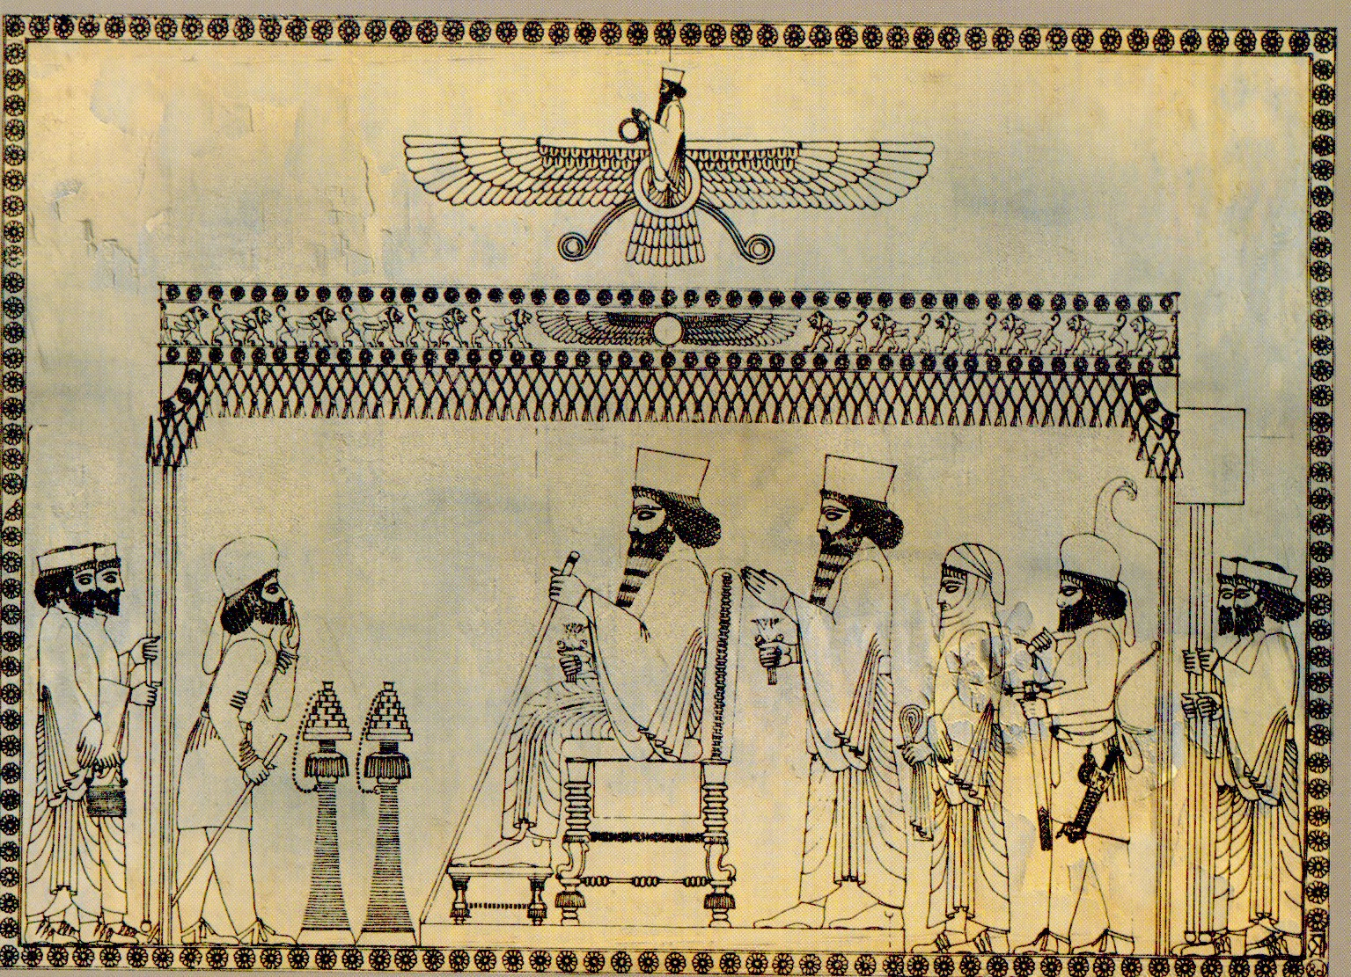
Persian Government
King was absolute ruler
Decentralized administration
Allowed widespread local autonomy
Local leaders enforced Persian laws
Respected local institutions and religious practices

Slide 3
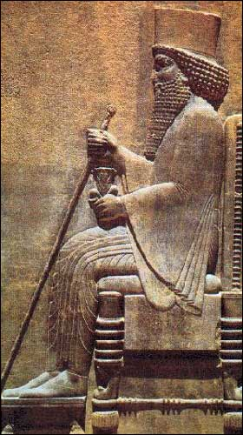
Darius the Great
Reigned from 522 to 486 B.C.E.
Conquered lands in the Indus River valley in 515 B.C.E.
Conquered lands around the Black Sea
Defeated the Scythians in 513 B.C.E.

Slide 4
Government Reforms
Under Darius
Divided the empire in to 20 provinces, or satrapies
Appointed a family member as governor, or satrap, to oversee a province
Governor was military leader, judicial leader and tax collector
Taxes for each province depended on an average of harvest years

Slide 5
Government Reforms
Under Darius
Stationed a permanent military garrison in each province responsible only to the king
Surprise inspections by teams of inspectors responsible only to the king
Established a road system with messenger relay stations to speed up reports of unrest
Standardized laws and monetary system
Standardized weights and measurements

Slide 6
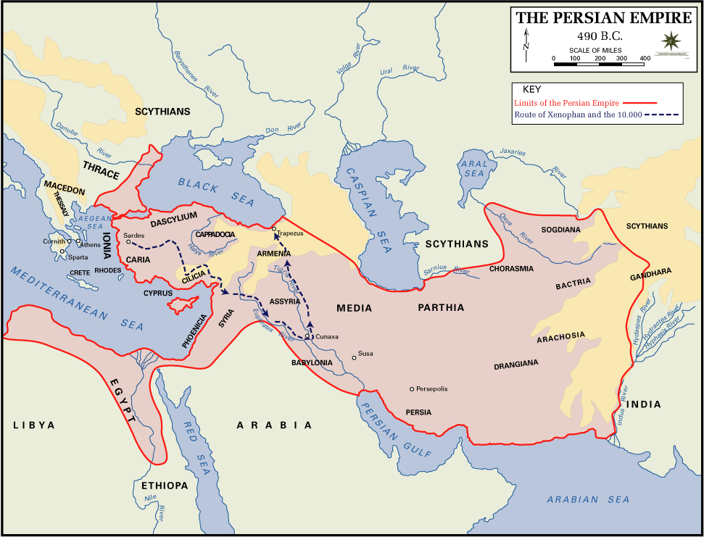
Greco – Persian Wars
Darius I invaded Greece in 490 B.C.E.
Persians defeated at the Battle of Marathon in late 490 B.C.E.
2nd invasion of Greece under Xerxes I in 480 B.C.E.

Slide 7
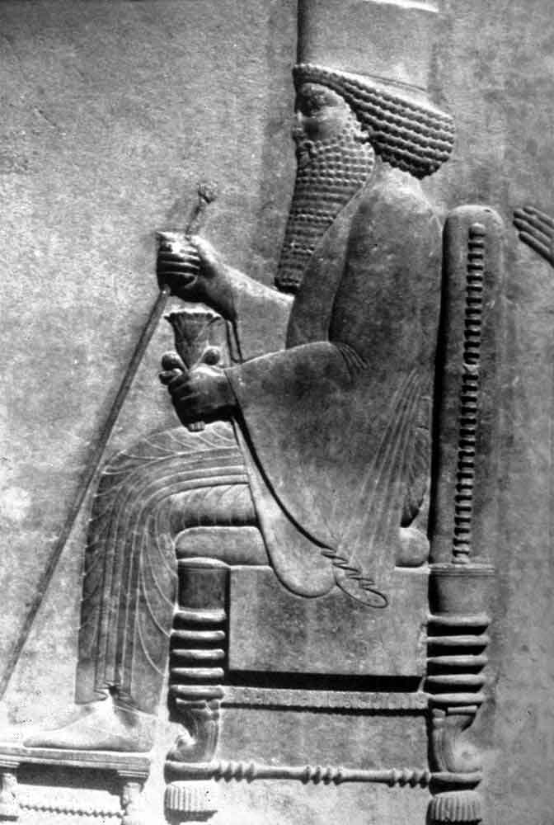
Xerxes the Great
Reigned from 486 to 465 B.C.E.
Crushed revolts in Egypt and Babylon in 484 B.C.E.
Angered by Greek resistance following the defeat of his father
Began to make preparations for 2nd invasion of Greece

Slide 8
Xerxes I and Greece
Amassed about 150,000 men and 600 ships
Launched the 2nd invasion of Greece from Sardis in August 480 B.C.E.
Battle of Thermopylae in September 480 B.C.E.
Greeks led by King Leonidas of Sparta

Slide 9
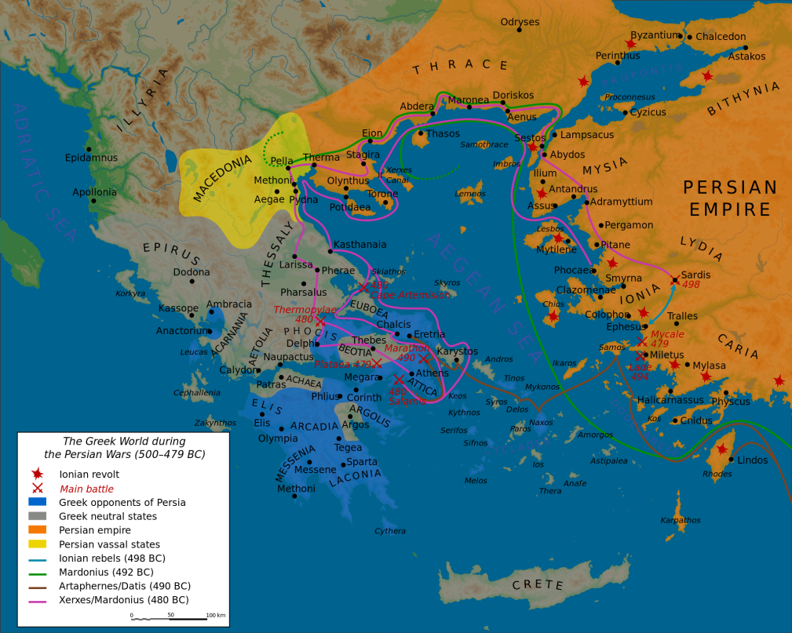
Invasion of Greece
Naval Battle of Salamis in September 480 B.C.E.
Persians camped for the winter in Thessaly
Persians defeated by the combined armies of Greece at the Battle of Plataea in 479 B.C.E.
Persian forces withdrew back to Persia

Slide 10
Aftermath of Greco-Persian Wars
Athens and Sparta emerged as the leading city-states in Greece
Persia remained involved in Greek politics
The 1st Peloponnesian War 460 - 445 B.C.E.
The 2nd Peloponnesian War 431 - 404 B.C.E.
In 387 B.C.E. Persia openly supported Sparta breaking the power of Athens and its allies

Slide 11
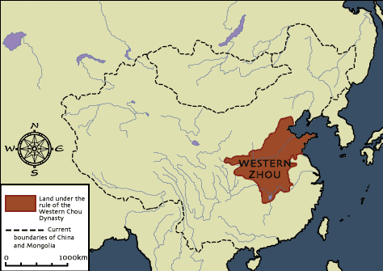
Western Zhou Dynasty
Conquered the Shang around 1050 B.C.E.
Maintained Shang culture and institutions
Maintained Shang hierarchical political structure
Established the idea of “Mandate of Heaven”

Slide 12
Western Zhou Dynasty
Consisted of 70 small feudal like states
Placed family members as rulers of satellite states
Promoted agricultural advancements, such as the iron plow, canals and irrigation systems
Fell into decline by 771 B.C.E.
Shaped the future of China

Slide 13
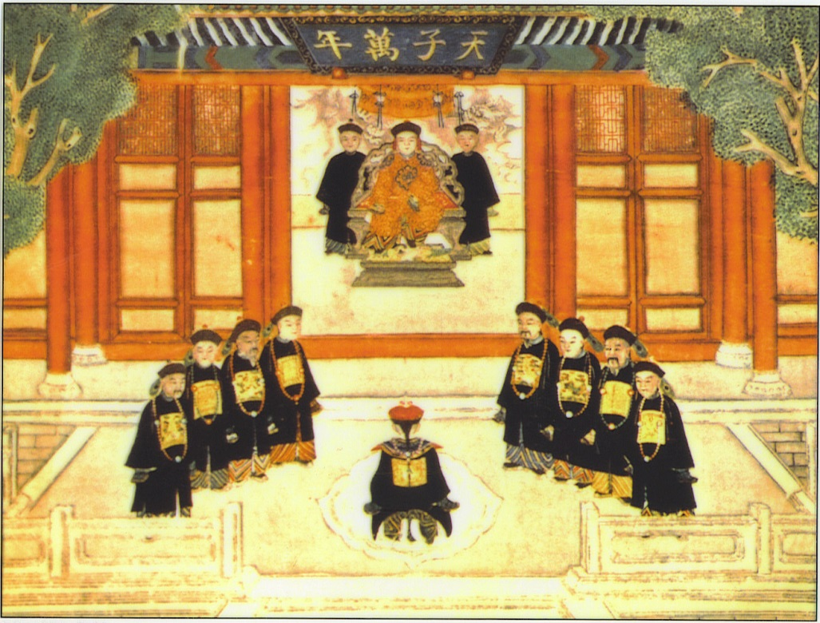
Mandate of Heaven
Idea introduced by King Wu around 1045 B.C.E.
Asserted Zhou moral superiority
Presented as a religious pact between the people and their deity
Evolved in to Chinese political doctrine

Slide 14
Under Zhou Rule
Created royal calendars based on celestial events
Used agricultural activities and religious rituals to maintain and legitimize their mandate as rulers
Celestial events and natural disasters brought in to question the legitimacy of the dynasty’s mandate to rule
Chinese society became more class based as it became more integrated

Slide 15
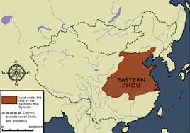
Eastern Zhou Dynasty
Divided into (2) periods: Spring and Autumn and Warring States
A period of decline for royal power
King became more of a ritual figurehead
Conquered by the Qin in 256 B.C.E.

Slide 16
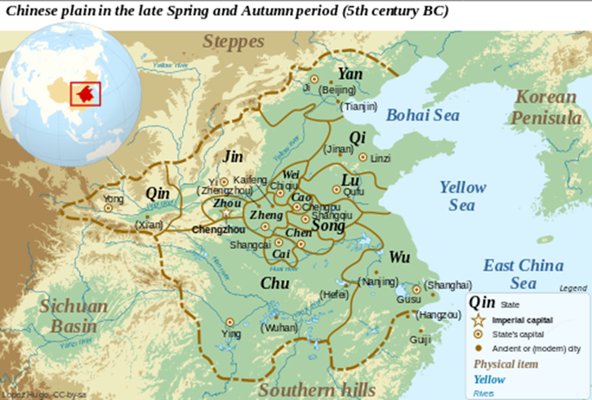
Spring and Autumn Period
In 771 B.C.E. the Zhou were forced eastward ushering in the Spring and Autumn Period
Named for the Spring and Autumn Annals of the State of Lu
Beginning of the Eastern Zhou Dynasty
Local lords began to challenge royal power

Slide 17

Spring and Autumn Period
Local lords gained control over cities and provinces forming independent kingdoms
By 550 B.C.E. there were many independent states
Ruled over small city- states by 481 B.C.E.
By 476 B.C.E. China consisted of (7) major independent states

Slide 18
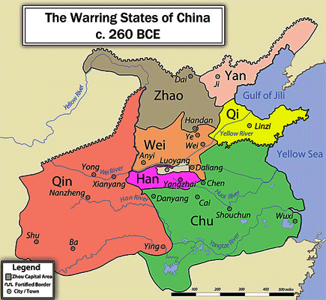
Warring States Period
Began in 481 B.C.E.
Named for the Han Dynasty work, Record of the Warring States
Rulers claimed the Mandate of Heaven when conquering their neighbor
Ruling families tried to expand their power and influence in China

Slide 19
Unification of China
The state of Jin was defeated and divided between 453 – 376 B.C.E.
War among the remaining states continued between 370 – 319 B.C.E.
By 319 B.C.E. only the states of Qi, Qin, Zhao and Zhou remained
In 256 B.C.E. the army of the Qin defeated the Zhou

Slide 20
The Qin Unite China
In 247 B.C.E. the Qin began the conquest of the remaining states
In 230 B.C.E. conquered the Han
In 225 B.C.E. conquered the Wei
In 223 B.C.E. conquered the Chu
In 222 B.C.E. conquered the Zhao and Yan
In 221 B.C.E. conquered the Qi

